Slide 1

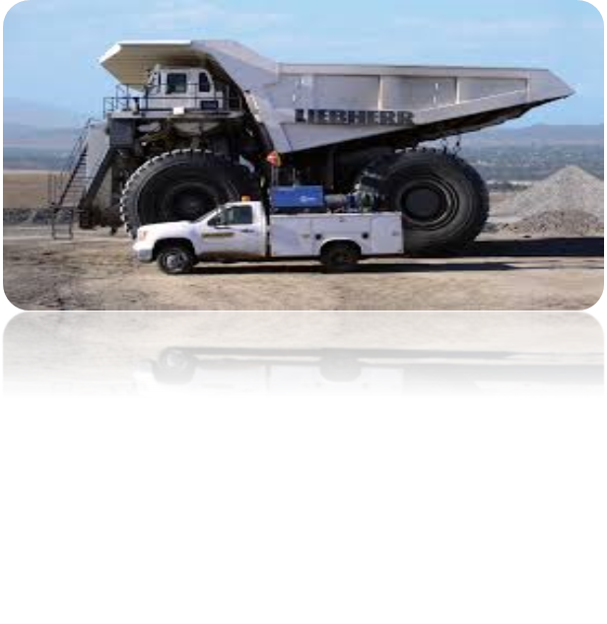

Real-time System

Slide 2
Syllabus
1. Real-Time: Concepts 8 Hrs
1.1 Terminologies:
  1.1.1 Systems Concepts
  1.1.2 Real-Time Definitions
  1.1.2.1 Hard, Soft and Firm Real-Time Systems
  1.1.3 Types of Real-Time Tasks
  1.1.3.1 Periodic, Aperiodic and Sporadic Tasks
  1.1.4 Events and Determinism
  1.1.5 CPU Utilization
1.2 Real-Time System Design Issues
1.3 Examples of Real-Time Systems
1.4 Common Misconceptions regarding Real-Time Systems
1.5 Historical Aspects of Real-Time Systems
1.6 Brief Survey of Real-Time Programming Languages
1.6.1 Ada 95, C, C++, C#, Fortran, Java, Occam 2, Special Real-Time Languages

Slide 3
Syllabus
2 Real-Time Specification and Design Techniques 4 Hrs
2.1 Requirements Specification for Real-Time Systems
2.1.1 Z, Finite State Machines, State Charts, Petri Nets
2.2 Recommendations on Specification Approach for Real-Time Systems
2.3 Real-Time System Design Activity
  2.3.1 Problems with Structured Analysis and Structured Design in Real-Time Applications
  2.3.2 Real-Time Extensions of Structured Analysis and Structured Design
  2.3.3 Real-Time Extensions of Unified Modeling Language

Slide 4
Syllabus
3 Real-Time Operating Systems 8 Hrs
3.1 Real-Time Kernels
  3.1.1 Nano Kernel and Micro Kernel
  3.1.2 Pseudokernels
  3.1.3 Interrupt-Driven Systems
  3.1.4 Preemptive-Priority Systems
  3.1.5 Hybrid Systems
  3.1.6 The Task-Control Block Model
  3.1.6.1 Task States
  3.1.6.2 Task Management
  3.1.6.3 Resource Management
3.2 Theoretical Foundations of Real-Time Operating Systems
  3.2.1 Process Scheduling
    3.2.1.1 Task Characteristics of a Real Workload
    3.2.1.2 Typical Task Model
  3.2.2 Round-Robin Scheduling
  3.2.3 Cyclic Executives
  3.2.4 Fixed-Priority Scheduling–Rate-Monotonic Approach
  3.2.5 Dynamic-Priority Scheduling: Earliest-Deadline–First Approach

Slide 5
Syllabus
4 Inter-task Communication, Synchronization and Memory Management 7 Hrs
4.1Intertask Synchronization Mechanisms and Resource Contention
  4.1.1 Buffering Data: Time-Relative Buffering, Ring Buffers
  4.1.2 Mailboxes
  4.1.3 Critical Regions
  4.1.4 Semaphores
  4.1.5 Resource Contentions and Priority Inversion
    4.1.5.1The Priority Inheritance Protocol
    4.1.5.2 Priority Ceiling Protocol
4.2 Real-Time Memory Management
  4.2.1 Process Stack Management
  4.2.2 Multiple-Stack Arrangements
  4.2.3 Memory Management in the Task-Control-Block Model
  4.2.4 Swapping
  4.2.5 Overlays
  4.2.6 Block or Page Management
  4.2.7 Memory Locking
  4.2.8 Working Sets
  4.2.9 Real-Time Garbage Collection
  4.2.10 Contiguous File Systems

Slide 6
Syllabus
5 Performance Analysis And Optimization of Real-Time Systems 6 Hrs
5.1 Challenges in Analyzing Real-Time Systems
5.2 Performance Analysis
  5.2.1 Analysis of Round-Robin Systems
  5.2.2 Response-Time Analysis for Fixed-Period Systems
  5.2.3 Response-Time Analysis: RMA Example
  5.2.4 Analysis of Sporadic and Aperiodic Interrupt Systems
5.3 Performance Optimization
  5.3.1 Compute at Slowest Cycle
  5.3.2 Scaled Numbers
  5.3.3 Binary Angular Measure
  5.3.4 Optimizing Memory Usage
5.4 Analysis of Memory Requirements
5.5 Reducing Memory Utilization
  5.5.1 Variable Selection
  5.5.2 Memory Fragmentation

Slide 7
Syllabus
6 Fault-Tolerance and System Integration Tools and Techniques 6 Hrs
6.1 Faults and Fault-Tolerance
  6.1.1 Spatial Fault-Tolerance
  6.1.2 Software Black Boxes
  6.1.3 N-Version Programming
  6.1.4 Built-In-Test Software
6.2 Systems Integration
  6.2.1 Goals of System Integration
  6.2.2 System Unification
  6.2.3 System Verification
  6.2.4 System Integration Tools
  6.2.5 A Simple Integration Strategy
  6.2.6 Patching
  6.2.7 The Probe Effect

Slide 8
Syllabus
7 Case Study: Real-time POSIX 6 Hrs
7.1 Threads and Pthreads
  3.5.1.1 Multi-threaded Real-Time Applications
  3.5.1.2 Thread Creation Mechanism
  3.5.1.3 Thread Priority, Thread Periodicity
7.2 POSIX Mutexes and Condition Variables
7.3 POSIX Semaphores and Shared Memory
7.4 POSIX Messages
7.5 Real-Time POSIX Signals
7.6 Clocks and Timers
7.7 POSIX Memory Locking

Slide 9
Lab
Linux/Basic Commands
Processes and Threads (POSIX)
Real Time Experiments
  System Calls
  Measuring Latency
  Multitasking
  Message Que
  Semaphors/Synchronization
RT Linux
Module Programming
RT UML (Rational Rose Real-time)

Slide 10
Text Books:
Laplante, Phillip A., Real-Time System Design and Analysis – An Engineer’s Hand-Book, 3rd Edition, IEEE Press, IEEE Computer Society Press, PHI, 2004, ISBN: 81-203-1684-3
Liu. Jane W.S., Real-Time Systems, PHI, 2009, ISBN:978-81-7758-575-9

Slide 11
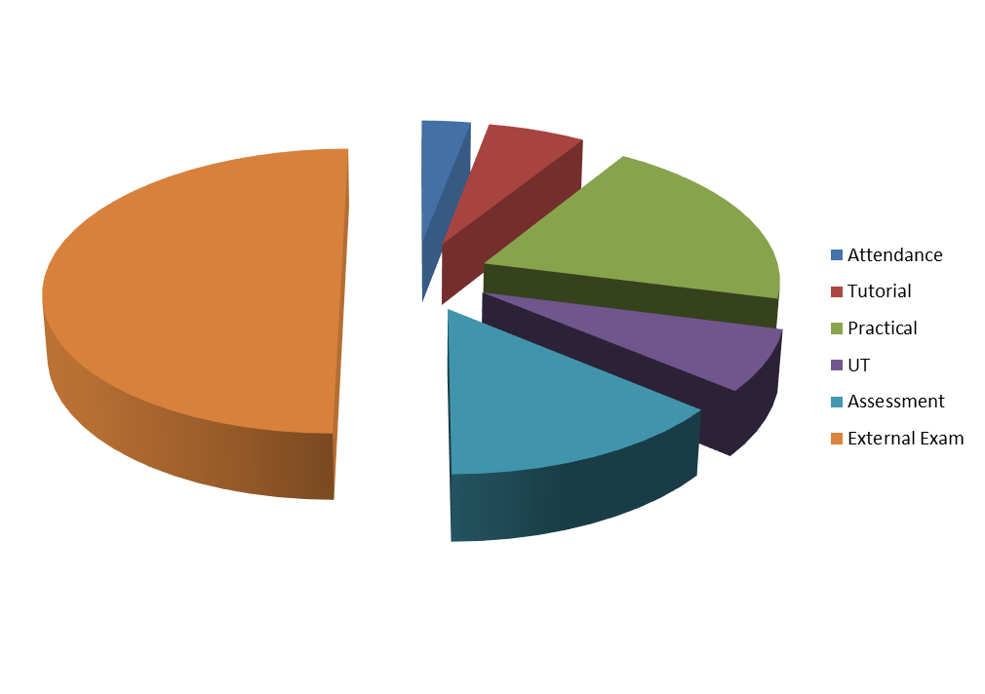
Marks Distribution:
3
6
20
50
7
14

Slide 12
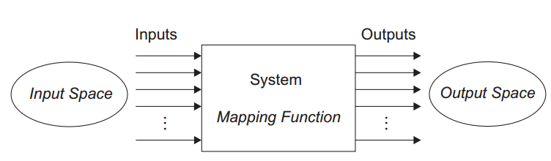
System
A system is a mapping of a set of inputs into a set of outputs.

Slide 13
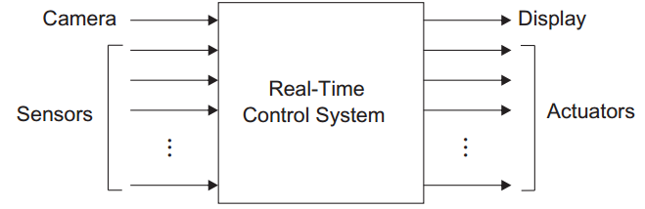
General properties of a System
A system is an assembly of components connected together in an organized way.
A system is fundamentally altered if a component joins or leaves it.
It has a purpose.
It has a degree of permanence.
It has been defined as being of particular interest.

Slide 14
Real-time System
“ realtime ” pertaining to applications in which the computer must respond as rapidly as required by the user or necessitated by the process being controlled
A computer system in which data need to be processed at a regular rate
An aircraft uses a sequence of accelerometer pulses to determine its position
Handling an over temperature failure in a nuclear power plant
An airline check-in counter issuing a boarding pass to a client for a flight that is leaving in five minutes

Slide 15
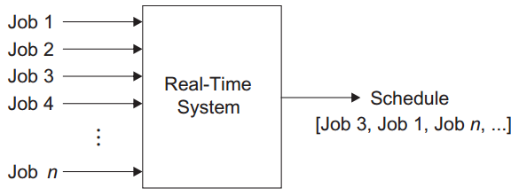
Real-time System
A real - time system is a computer system that must satisfy bounded response - time constraints or risk severe consequences, including failure.
A real - time system is one whose logical correctness is based on both the correctness of the outputs and their timeliness
Real - time systems are often reactive or embedded systems.

Slide 16
Real-time System
Reactive systems are those in which task scheduling is driven by ongoing interaction with their environment
a fire-control system reacts to certain buttons pressed by a pilot
Is a batch - oriented system grade processing at the end of a semester or a bimonthly payroll run real – time?
Although the system may have response times of days or even weeks (e.g., the time that elapses between submitting the grade or payroll information and issuance of the report card or paycheck), it must respond within a certain time or there could be an academic or financial disaster.
Is a word processing program a real – time application?
Even a word - processing program should respond to commands within a reasonable amount of time or it will become torturous to use.

Slide 17
Response Time
The time between the presentation of a set of inputs to a system and the realization of the required behavior, including the availability of all associated outputs, is called the response time of the system.
Turnaround time: The interval between the submission of a
job and its completion.
Response time: The interval between submission of a request, and the first response to that request
How fast and punctual the response time needs to be depends on the characteristics and purpose of the specific system

Slide 18
Types of Real-time Systems
Soft Real - Time System A soft real - time system is one in which performance is degraded but not destroyed by failure to meet response - time constraints.
Hard Real - Time System A hard real - time system is one in which failure to meet even a single deadline may lead to complete or catastrophic system failure.
Firm Real - Time System A firm real - time system is one in which a few missed deadlines will not lead to total failure, but missing more than a few may lead to complete or catastrophic system failure.

Slide 19
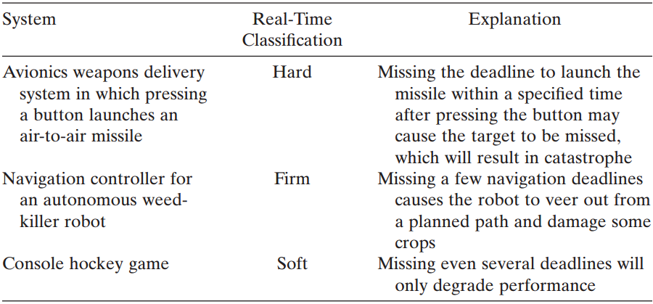
Types of Real-time Systems

Slide 20
Failed system
The inability of the system to perform according to system specification
A failed system is a system that cannot satisfy one or more of the requirements stipulated in the system requirements specification.

Slide 21
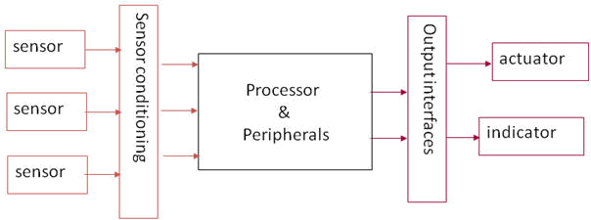
Embedded System
An embedded system is a system containing one or more computers (or processors) having a central role in the functionality of the system, but the system is not explicitly called a computer

Slide 22
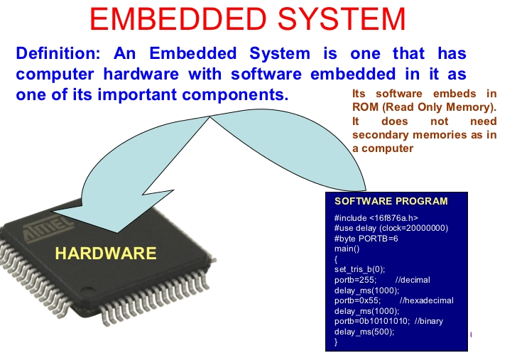

Slide 23
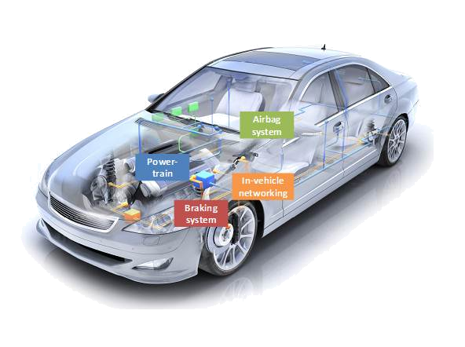
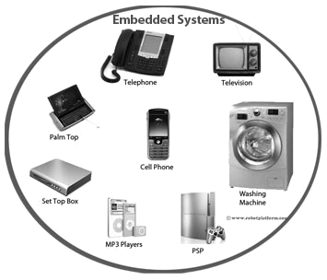
Embedded System
Modern car contains many embedded processors that control
airbag deployment
antilock braking
air conditioning
fuel injection
Today, numerous household items, such as microwave ovens, rice cookers, stereos, televisions, washing machines, even toys, contain embedded computers.

Slide 24
Event
Any occurrence that causes the program counter to change non sequentially is considered a change of flow-of-control, and thus an event. In scheduling theory, the release time of a job is similar to an event
Synchronous events
Those that occur at predictable times in the flow-of-control
Asynchronous events
Occur at unpredictable points in the flow-of-control and are usually caused by external sources
Chat , ATM, Web Browser and Email???

Slide 25
Release Time
The release time is the time at which an instance of a scheduled task is ready to run, and is generally associated with an interrupt.
Deterministic System
A system is deterministic, if for each possible state and each set of inputs, a unique set of outputs and next state of the system can be determined
nondeterministic systems would be desirable, for example, as casino gaming machines

Slide 26


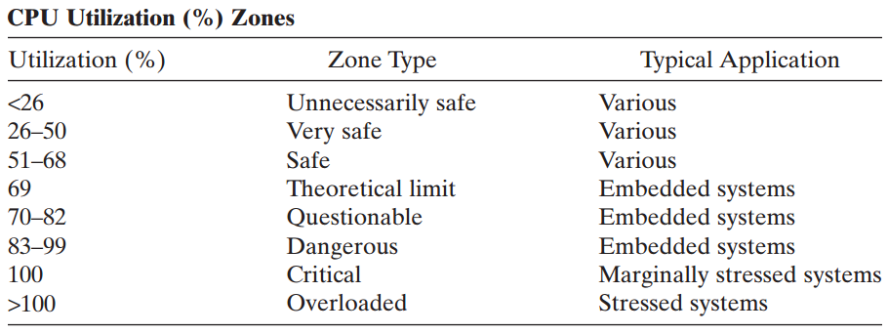
CPU Utilization Factor
The CPU utilization or time-loading factor, U , is a relative measure of the non idle processing taking place.
A system is said to be time-overloaded if U > 100%

Slide 27

Calculation of CPU Utilization Factor
An individual elevator controller in a bank of high-rise elevators has the following software tasks with execution periods of p_{i} and worst - case execution times of e_{i} , i ∈ {1, 2, 3, 4}:
Task 1 : Communicate with the group dispatcher (19.2 K bit/s data rate and a proprietary communications protocol); p₁ = 500 ms, e₁ = 17 ms.
Task 2 : Update the car position information and manage floor-to-floor runs, as well as door control; p₂ = 25 ms, e₂ = 4 ms.
Task 3 : Register and cancel car calls; p₃ = 75 ms, e₃ = 1 ms.
Task 4 : Miscellaneous system supervisions; p₄ = 200 ms, e₄ = 20 ms.
What is the overall CPU utilization factor?

Slide 28
Usual Misconceptions
Real - time systems are synonymous with “ fast ” systems.
many hard real - time systems indeed deal with deadlines in the tens of milliseconds, such as the aircraft navigation system
Rate - monotonic analysis has solved “ the real - time problem. ”
There are universal, widely accepted methodologies for real-time systems specification and design.
There is no more a need to build a real-time operating system, because many commercial products exist.
The study of real - time systems is mostly about scheduling theory

Slide 29
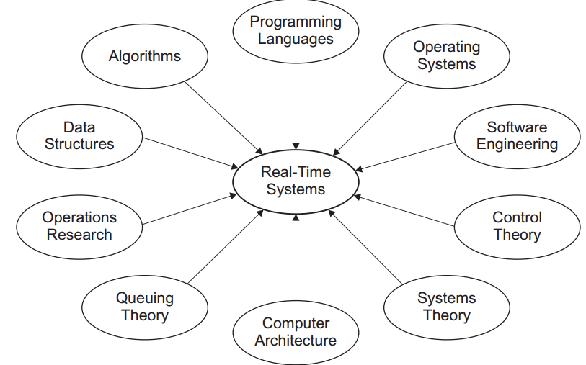
MULTIDISCIPLINARY DESIGN CHALLENGES
?
?
?
?
?
?
?
?

Slide 30
Design Issues
The design and implementation of real - time systems requires attention to numerous practical issues. These include:
• The selection of hardware and system software, and evaluation of the trade - off needed for a competitive solution, including dealing with distributed computing systems and the issues of concurrency and synchronization.
• Specification and design of real - time systems, as well as correct and inclusive representation of temporal behavior.
• Understanding the nuances of the high-level programming language(s) and the real-time implications resulting from their optimized compilation into machine - language code.

Slide 31
Design Issues
The design and implementation of real - time systems requires attention to numerous practical issues. These include:
• Optimizing (with application-specific objectives) of system fault tolerance and reliability through careful design and analysis.
• The design and administration of adequate tests at different levels of hierarchy, and the selection of appropriate development tools and test equipment.
• Taking advantage of open systems technology and interoperability. An open system is an extensible collection of independently written applications that cooperate to function as an integrated system. For example, several versions of the open operating system, Linux, have emerged for use in various real-time applications. Interoperability can be measured in terms of compliance with open system standards, such as the real-time CORBA( common object request broker architecture ) standard.
• Finally, estimating and measuring response times and (if needed) reducing them. Performing a schedulability analysis, that is, determining and guaranteeing deadline satisfaction, a priori .

Slide 32
Historical Aspect of Real time systems
History of real-time systems is tied inherently to evolution of computer
Modern real-time systems, such as nuclear power plant controller, military weapons systems, or medical monitoring equipment, are sophisticated, yet many still exhibit characteristics of those pioneering systems developed in the 1940s through the 1960s.
Much of the theory of real-time systems is derived from disciplines like operations research ( scheduling) from late 1940s, and queuing theory in early 1950s

Slide 33
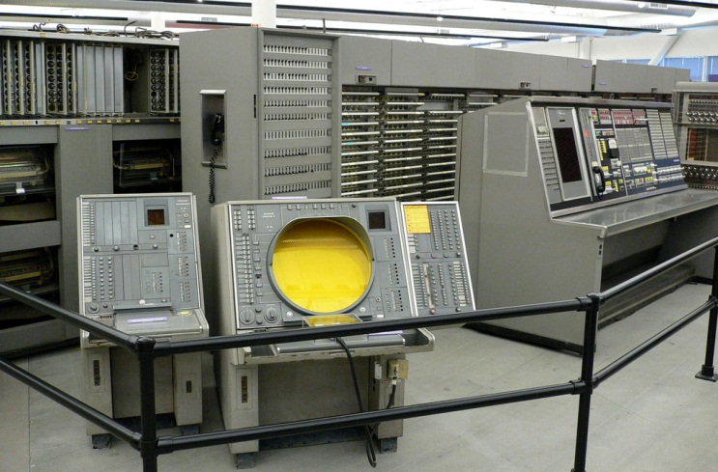
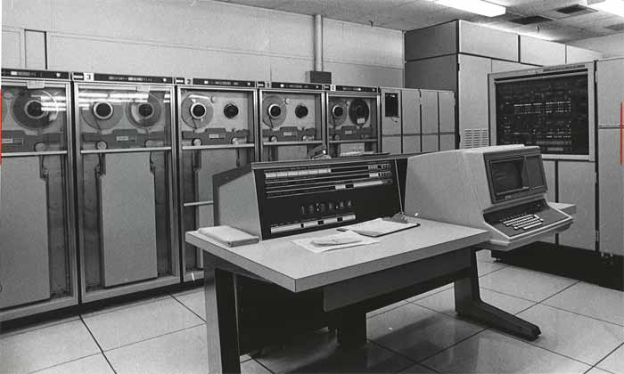
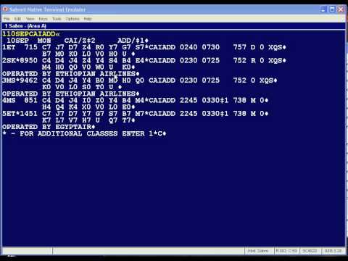
Historical Aspect of Real time systems
1947: Whirlwind, a flight simulator developed by IBM for the U.S. Navy, SAGE, the Semiautomatic Ground Environment air defense system developed for the U.S. Air Force in the late 1950s
Early1950: asynchronous interrupt introduced and later incorporated as a standard feature in Univac Scientific 1103A.
Middle 1950: Increase in the speed and complexity of large-scale computers designed for scientific computation, without an increase in physical size.
1959: Airline reservations such as SABRE developed for American Airlines , advanced real-Time systems for spacecraft control

Slide 34
Historical Aspect of Real time systems
1960s and 1970s: advances in integration levels and processing speeds enhanced the spectrum of real - time problems that could be solved.
1965: it was estimated that more than 350 real-time process control systems existed.
1973: Liu and Layland published their seminal work on rate - monotonic theory
1980s and 1990s: Theoretical work on improving predictability and reliability of real-time systems, and on solving problems related to multitasking systems for instance, distributed systems and non - von Neumann architectures utilized in real - time applications.

Slide 35
Historical Aspect of Real time systems
Late 1990s and early 2000s: New trends in real-time embedded systems in consumer products and Web - enabled devices.
Today, a rather small group of experts continues to study pure issues of scheduling and performance analysis, while a larger group of generalist systems engineers tackles broader issues relating to the implementation of practical systems.
The availability of compact processors with limited memory and functionality has rejuvenated some of the challenges faced by early real - time systems designers.

Slide 36
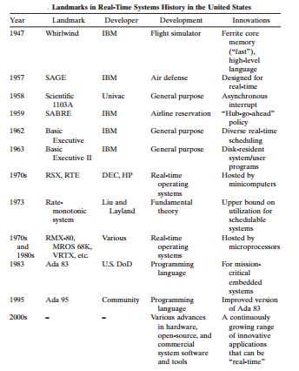

Slide 37
Historical Aspect of Realtime Programming Languages
Early real - time systems written directly in microcode or assembly language, and later in higher-level languages.
Whirlwind used an early form of high - level language called an algebraic compiler to simplify coding. Later systems employed Fortran, CMS - 2, and JOVIAL, the preferred languages in the U.S. Army, Navy, and Air Force, respectively.
In the 1970s, the Department of Defense ( DoD ) mandated the development of a single language that all military services could use, and that provided high - level language constructs for real - time programming. After a careful selection and refinement process, the

Slide 38
Historical Aspect of Realtime Programming Languages
Ada language appeared as a standard in 1983.
Shortfalls in the language were identified, and a new, improved version of the language, Ada 95, appeared in 1995.
Today, most embedded systems are written in C or C ++ there is an increase in the use of object - oriented methodologies, and languages like C ++ and Java in embedded real - time systems.

Slide 39
Historical Aspect of Realtime Operating Systems
The first commercial operating systems were designed for the early mainframe computers. IBM developed the first real-time executive, the Basic Executive, in 1962, which provided diverse real - time scheduling.
By 1963, the Basic Executive II had disk-resident system and user programs.
By the mid - 1970s, more affordable minicomputer systems could be found in many engineering environments.

Slide 40
Historical Aspect of Realtime Operating Systems
In response, a number of important real - time operating systems were developed by the minicomputer manufacturers. Like Digital Equipment Corporation ( DEC ) family of real - time multitasking executives ( RSX ) for the PDP - 11, and Hewlett - Packard ’ s Real - Time Executive ( RTE ) series of operating systems for its HP 2000 product line.
By the late 1970s and early 1980s, the first real - time operating systems for microprocessor-based applications appeared. These included RMX - 80, MROS 68K, VRTX, and several others.
Over the past 30 years, many commercial real - time operating systems have appeared, and many have disappeared.

Slide 41
Historical Aspect of Realtime Operating Systems
In response, a number of important real - time operating systems were developed by the minicomputer manufacturers. Like Digital Equipment Corporation ( DEC ) family of real - time multitasking executives ( RSX ) for the PDP - 11, and Hewlett - Packard ’ s Real - Time Executive ( RTE ) series of operating systems for its HP 2000 product line.
By the late 1970s and early 1980s, the first real - time operating systems for microprocessor-based applications appeared. These included RMX - 80, MROS 68K, VRTX, and several others.
Over the past 30 years, many commercial real - time operating systems have appeared, and many have disappeared.

Slide 42
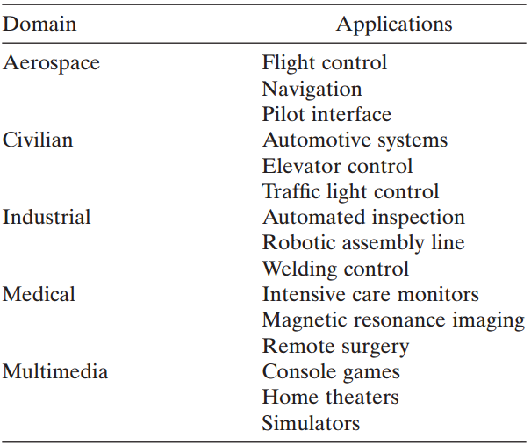
Real time application domains

Slide 43
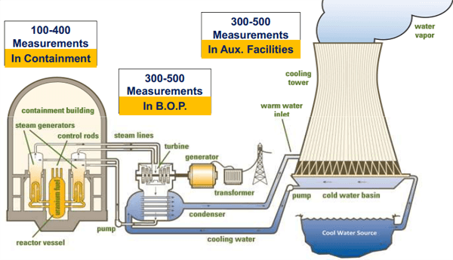
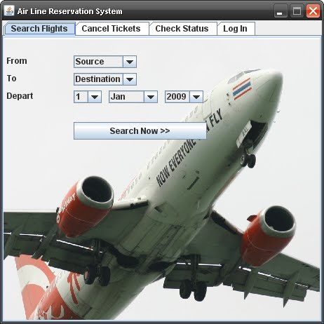
Real time application domains
monitoring system for a nuclear power plant
  The system must respond to this signal within one second.
  The second and most important event indicates that the reactor core has reached an overtemperature.
  This signal must be dealt with within 1 millisecond (1 ms).
  Finally, an operator ’ s display is to be updated at approximately 30 times per second.
airline reservation system
  Turnaround time for any transaction must be less than 15 seconds, and no overbooking permitted to prevent long lines and customer dissatisfaction
  At any time, several travel agents may try to access the reservations database and perhaps book the same flight simultaneously.
  Effective record-locking and secure communications mechanisms needed to protect against the alteration of the database containing the reservation information by more than one clerk at a time.

Slide 44
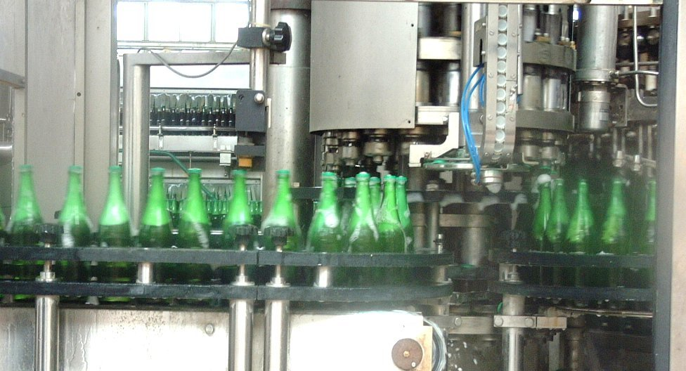
Real time application domains
Bottling Plant of Jars of Pasta Sauce
  Empty jars are first microwaved to disinfect them.
  A mechanism fills each jar with a precise serving of specific sauce as it passes beneath.
  Another station caps the filled bottles.
  In addition, there is an operator’s display that provides an animated rendering of the production line activities.
  There are numerous events triggered by exceptional conditions, such as the conveyor belt jamming and a bottle overflowing or breaking.
  If the conveyor belt travels too fast, the bottle will move past its designated station prematurely

Slide 45
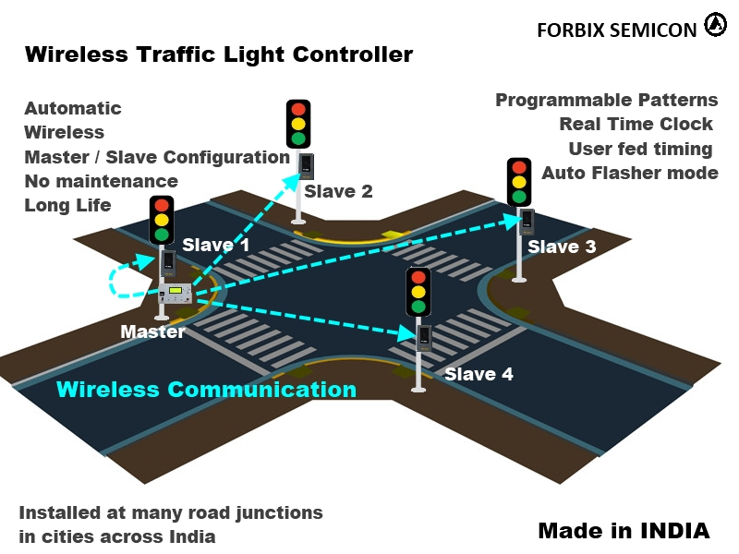
Real time application domains
Traffic Light System
  Input may be taken from cameras, emergency-vehicle transponders, push buttons, sensors under the ground, and so on.
  Traffic lights need to operate in a synchronized fashion, and yet react to asynchronous events such as a pedestrian pressing a button at a crosswalk.
  Failure to operate in a proper fashion can result in automobile accidents and even fatalities

Slide 46
Real time Programming Languages:Ada
Ada was originally planned to be the mandatory language for all U.S. DoD projects that included a high proportion of real time embedded systems.
The first version, which became standardized by 1983, had rather serious problems.
- resulting executable code were bulky and inefficient
- problemsin implementing multitasking.
Thoroughly revised“Ada 95” considered the first internationally standardized object - oriented programming language or the“ first real-time language. ”

Slide 47
Real time application domains
Three useful constructs introduced in Ada 95 to resolve shortcomings of Ada 83 in scheduling, resource contention, and synchronization:
1. A pragma that controls how tasks are dispatched.
2. A pragma that controls the interaction between task scheduling.
3. A pragma that controls the queuing policy of task - and resource - entry queues.
Other additions to the language strived to make Ada 95 fully object-oriented:
• Tagged types • Packages • Protected units
These constructs allows for the construction of objects that exhibit the four characteristics of object - oriented languages:
Abstract data typing Inheritance
Polymorphism Messaging.

Slide 48
Real time application domains
This latest version of Ada is called “ Ada 2005” has the following changes:
The real - time systems Annex contains additional dispatching policies, support for timing events, and support for control of CPU - time utilization.
• The object - oriented model was improved to provide multiple inheritance.
• The overall reliability of the language was enhanced by numerous improvements.

Slide 49
Real time Programming Languages:C ++
C ++ is a hybrid object - oriented programming language that was originally implemented as a macro extension of C in the 1980s.
Choosing C in lieu of C ++ in embedded applications is a difficult trade-off:
C program would be faster and more predictable but harder to maintain
C ++ program would be slower and less predictable but potentially easier to maintain.

Slide 50
Real time Programming Languages:C ++
C ++ still allows for low-level control; for instance, it can use inlinemethods rather than a runtime call, acceptable in typical embedded environments.
C ++ does not provide automatic garbage collection
When converting a C program to C ++ , a complete redesign is required to fully capture all of the advantages of an object - oriented design while minimizing the runtime disadvantages.

Slide 51
Real time Programming Languages: C#
C# (pronounced “ C sharp ” ) is a C ++ - like language that, along with its operating environment, has similarities to Java and the Java virtual machine, respectively.
C# is first compiled into an intermediate language, which is then used to generate a native image at runtime.
C# is associated with Microsoft ’ s .NET framework for scaled-down operating systems like Windows CE.
Windows CE is highly configurable, capable of scaling from small, embedded system footprints ( < 1 M bytes) and upwards (e.g., for real-time systems requiring user-interface support).
The minimum kernel configuration provides basic networking support, thread management, dynamic link library support, and virtual memory management.

Slide 52
Real time Programming Languages: C#
Windows CE was originally intended as a real-time operating system for the .NET platform.
C# supports “unsafe code ” allowing pointers to refer to specific memory locations.
Objects referenced by pointers must be explicitly “pinned” disallowing the garbage collector from altering their location in memory. The garbage collector collects pinned objects; it just does not move them. This capability could increase schedulability
It also allows for direct memory access ( DMA ) to write to specific memory locations; a necessary capability in embedded real - time systems.

Slide 53
Real time Programming Languages: C#
C# supports an array of thread - synchronization constructs: lock, monitor, mutex, and interlock.
A Lock is semantically identical to a critical section—a code segment guaranteeing entry into itself by only one thread at a time.
A mutex is semantically equivalent to a lock, with the additional capability of working across process spaces. The downside to mutexes is their performance penalty.
Interlock, a set of overloaded static methods, is used to increment and decrement numerics in a thread-safe manner in order to implement the priority-inheritance protocol.

Slide 54
Real time Programming Languages: C#
Timers that are similar in functionality to the widely used Win32 timer exist in C#.
When constructed, timers are configured how long to wait in milliseconds before their first invocation, and are also supplied an interval, again in milliseconds, specifying the period between subsequent invocations.
The accuracy of these timers is machine dependent, and thus not guaranteed, reducing their usefulness in real - time systems to be used in multiple hardware platforms.

Slide 55
Real time Programming Languages: C#
C# and the .NET platform are not appropriate for the majority of hard real - time systems:
the unbounded execution of its garbage - collection environment
lack of threading constructs to adequately support schedulability and determinism.
C#’s ability to interact effectively with operating-system APIs, shields developers from complex memory management logic, together with C# ’ s good floating-point performance, makes it a programming language that is highly potential for soft and even firm real - time applications.

Slide 56
Real time Programming Languages: Java
Java is an interpreted language, the code compiles into machine - independent intermediate code that runs in a managed execution environment.
This environment is a virtual machine (see Fig. 4.3 ), which executes “ object ” code instructions as a series of program directives so that Java code can run on any device that implements virtual machine.
This “write once, run anywhere ” philosophy has important applications in mobile and portable computing, such as in cell phones and smart cards, as well as in Web - based computing.
Native - code Java compilers, allow Java to run directly “ on the bare metal, ” as the compilers convert Java to assembly code or object code.
Beginning with Java 2, Java virtual machines support special compilers that compile into machine code for several standard architectures

Slide 57
Real time Programming Languages: Java
There are even special Java microprocessors, which directly execute Java byte code in hardware.
Like C, Java supports call-by-value, but call-by-reference can be simulated
The Java language does not support pointers, but it provides similar functionality via references.
Java is a pure object - oriented language, it does not support standalone functions, it requires programmers to bundle all routines into class methods.
Java has no direct support for multiple inheritance. Interfaces, however, allow for implementation of multiple inheritance. Java interfaces provide object-method descriptions, but contain no implementations.

Slide 58
Real time Programming Languages: Real-Time Java
Real-time Java is a modification of the standard Java language used increasingly in implementing soft, firm, and even hard real - time systems, while the standard Java is mainly used for soft real - time systems only.
Shortcomings making standard Java inadequate for most real - time systems.
A guarantee that the highest - priority one of ready threads will always be running, and thread priorities cannot be used to reliably implement mutual exclusion.

Slide 59
Real time Programming Languages: Real-Time Java
Nine core requirements for the real-time specification of Java (RTSJ 1.0) by National Institute of Standards and Technology ( NIST ) task force:
R1. The specification must include a framework for the lookup and discovery of available profiles.
R2. Any garbage collection that is provided shall have a bounded preemption latency.
R3. The specification must define the relationships among real-time Java threads at the same level of detail as is currently available in existing standards documents.
R4. The specification must include APIs to allow communication and synchronization between Java and non-Java tasks.
R5. The specification must include handling of both internal and external asynchronous events.
R6. The specification must include some form of asynchronous thread termination.
R7 . The core must provide mechanisms for enforcing mutual exclusion without blocking.
R8 . The specification must provide a mechanism to allow code to query whether it is running under a real-time Java thread or a non real-time Java thread.
R9 . The specification must define the relationships that exist between real-time Java and non real-time Java threads.
The RTSJ 1.0 satisfies all but the first requirement, which was considered irrelevant because access to physical memory is not part of the NIST requirements, but industry input led the group to include it
In 2006, an enhanced version of the real-time specification, RTSJ 1.1, was announced
The RTSJ defines the real - time thread class to create threads, which the resident scheduler executes.
Garbage Collection
Real - time threads can access objects on the heap, and therefore can incur delays because of garbage collection.
For garbage collection, the RTSJ extends the memory model to support memory management in a way that does not interfere with the real-time code ’ s ability to provide deterministic behavior.
These extensions allow both short-and long-lived objects to be allocated outside the garbage-collection heap.
There is also sufficient flexibility to use familiar solutions, such as preallocated object pools.
Priorities
RTSJ uses “ priority ” somewhat more loosely than is traditionally accepted.
“Highest priority thread” merely indicates the most eligible thread—the thread that the scheduler would choose from among all threads ready to run.
It does not necessarily presume a strict priority-based dispatch mechanism.
The system must queue all threads waiting to acquire a resource in priority order.
If the active scheduling policy permits threads with the same priority, the threads are queued using the FIFO principle.
Specifically, the system
(1) orders waiting threads to enter synchronized blocks in a priority queue;
(2) adds a blocked thread that becomes ready to run to the end of the ready queue for that priority; (3) adds a thread whose priority is explicitly set by itself or another thread to the end of the ready queue for the new priority; and
(4) places a thread that performs a yield to the end of its priority queue.
The priority - inheritance protocol is implemented by default.
AsyncEvent and AsyncEventHandler :
The asynchronous event facility comprises two classes:
AsyncEvent and AsyncEventHandler .
An AsyncEvent object represents something that can happen—like a hardware interrupt—or it represents a computed event—like an aircraft entering a monitored region.
When one of these events occurs, indicated by the fire() method being called, the system schedules associated AsyncEventHandlers .
An AsyncEvent manages two things:
the dispatching of handlers when the event is fired
the set of handlers associated with the event.
An AsyncEventHandler is a schedulable object roughly similar to a thread, when the event fires, the system invokes run() methods of the associated handlers.
an AsyncEventHandler has associated scheduling, release, and memory parameters that control the actual execution of read or write.
Asynchronous control transfer allows for identification of particular methods by declaring them to throw an AsynchronouslyInterrupted Exception ( AIE ).
Memory Access
The RTSJ defines two classes for programmers who want to access physical memory directly from Java code.
RawMemoryAccess , defines methods that let building an object representing a range of physical addresses and then access the physical memory with byte , word , long , and multiple byte granularity.
The RTSJ implies no semantics other than the set and get methods.
PhysicalMemory , allows the construction of a PhysicalMemoryArea object that represents a range of physical memory addresses where the system can locate Java objects.
For example, a new Java object in a particular PhysicalMemory object can be built using either the newInstance() or newArray() methods.
An instance of RawMemoryAccess models a raw storage area as a fixed - size sequence of bytes.

Slide 60
Real time Programming Languages: Real-Time Java
R6. The specification must include some form of asynchronous thread termination.
R7 . The core must provide mechanisms for enforcing mutual exclusion without blocking.
R8 . The specification must provide a mechanism to allow code to query whether it is running under a real-time Java thread or a non real-time Java thread.
R9 . The specification must define the relationships that exist between real-time Java and non real-time Java threads.
The RTSJ 1.0 satisfies all but the first requirement, which was considered irrelevant because access to physical memory is not part of the NIST requirements, but industry input led the group to include it
In 2006, an enhanced version of the real-time specification, RTSJ 1.1, was announced
The RTSJ defines the real - time thread class to create threads, which the resident scheduler executes.

Slide 61
Real time Programming Languages: Real-Time Java
Garbage Collection
Real - time threads can access objects on the heap, and therefore can incur delays because of garbage collection.
For garbage collection, the RTSJ extends the memory model to support memory management in a way that does not interfere with the real-time code ’ s ability to provide deterministic behavior.
These extensions allow both short-and long-lived objects to be allocated outside the garbage-collection heap.
There is also sufficient flexibility to use familiar solutions, such as preallocated object pools.

Slide 62
Real time Programming Languages: Real-Time Java
Priorities
RTSJ uses “ priority ” somewhat more loosely than is traditionally accepted.
“Highest priority thread” merely indicates the most eligible thread—the thread that the scheduler would choose from among all threads ready to run.
It does not necessarily presume a strict priority-based dispatch mechanism.
The system must queue all threads waiting to acquire a resource in priority order.
If the active scheduling policy permits threads with the same priority, the threads are queued using the FIFO principle.

Slide 63
Real time Programming Languages: Real-Time Java
Specifically, the system
(1) orders waiting threads to enter synchronized blocks in a priority queue;
(2) adds a blocked thread that becomes ready to run to the end of the ready queue for that priority; (3) adds a thread whose priority is explicitly set by itself or another thread to the end of the ready queue for the new priority; and
(4) places a thread that performs a yield to the end of its priority queue.
The priority - inheritance protocol is implemented by default.

Slide 64
Real time Programming Languages: Real-Time Java
AsyncEvent and AsyncEventHandler :
The asynchronous event facility comprises two classes:
AsyncEvent and AsyncEventHandler .
An AsyncEvent object represents something that can happen—like a hardware interrupt—or it represents a computed event—like an aircraft entering a monitored region.
When one of these events occurs, indicated by the fire() method being called, the system schedules associated AsyncEventHandlers .
An AsyncEvent manages two things:
the dispatching of handlers when the event is fired
the set of handlers associated with the event.

Slide 65
Real time Programming Languages: Real-Time Java
An AsyncEventHandler is a schedulable object roughly similar to a thread, when the event fires, the system invokes run() methods of the associated handlers.
an AsyncEventHandler has associated scheduling, release, and memory parameters that control the actual execution of read or write.
Asynchronous control transfer allows for identification of particular methods by declaring them to throw an AsynchronouslyInterrupted Exception ( AIE ).

Slide 66
Real time Programming Languages: Real-Time Java
Memory Access
The RTSJ defines two classes for programmers who want to access physical memory directly from Java code.
RawMemoryAccess , defines methods that let building an object representing a range of physical addresses and then access the physical memory with byte , word , long , and multiple byte granularity.
The RTSJ implies no semantics other than the set and get methods.
PhysicalMemory , allows the construction of a PhysicalMemoryArea object that represents a range of physical memory addresses where the system can locate Java objects.
For example, a new Java object in a particular PhysicalMemory object can be built using either the newInstance() or newArray() methods.
An instance of RawMemoryAccess models a raw storage area as a fixed - size sequence of bytes.

Slide 67
Special Real time Programming Languages
A large variety of specialized languages for real - time programming have appeared and received more or less success over the past decades. These include, for instance:
• PEARL .
The process and experiment automation real-time language was developed in the early 1970s by a group of German researchers.
PEARL uses the augmentation strategy and has fairly wide application in Germany, especially in industrial controls settings. The current version is PEARL - 90.
• Real - Time Euclid .
An experimental language also from the 1970s that enjoys the distinction of being one of the only languages to be completely suited for schedulability analysis, achieved through language restrictions.
It descended from the Pascal programming language, but never found its way into mainstream applications.

Slide 68
Special Real time Programming Languages
• Occam 2 .
A language based on the communicating-sequential-processes formalism that was designed to support concurrency on transputers (see Section 2.5.2 ).
It appeared in the late eighties and found practical implementations mainly in the United Kingdom, but disappeared together with the transputer.
• Real - Time C .
Actually a generic name for any of a variety of C macro extension packages.
These macro extensions typically provide timing and control constructs that are not found in standard C.

Slide 69
Special Real time Programming Languages
• Neuron ® C .
An enhancement to the standard C with extensions for event handling, network communications, and hardware I/O.
It is intended for supporting LonWorks (a fieldbus standard for control networking) applications for Neuron® processors and corresponding smart transceivers, and is used widely within the building automation community.
• Real - Time C ++ .
A generic name for one of several object-class libraries specifically developed for C ++ .
These libraries augment standard C ++ to provide an increased level of timing and control.
Furthermore, there are numerous other real-time languages and corresponding operating environments, such as Anima, DROL, Erlang, Esterel, Hume, JOVIAL, LUSTRE, Maruti, RLUCID, RSPL, and Timber. Some of these are used for highly specialized applications or in research only.

